Slide 1

CT4005: Games Production
Semester – Group Project
John Moss, Dr Will Sayers, University of Gloucestershire

Slide 2

FEEDBACK
First of all where credit is due.
The Doc and I thought the quality of writing was good overall and well done on your first assessment.
Hand in date is tomorrow and you up load Via the assessment point on Moodle.
If you want an extension then its there for grabs EC1, apply though student records.
Best of Luck……. Feedback on 20 days-ish

Slide 3

New start time - maybe?
Right….. Who like starting at 1115 -1415? I am proposing a move to start at 1015 finishing at 1315? What’s the consensus on this please

Slide 4
Overview
Semester 2
Ground rules for assignment 2
Effective Teamwork
Team Bonding
Exercise

Slide 5
Semester 2 – Key DATES
Please note lectures may change but timings will stay as timetabled

Slide 6
This assignment is group based and is composed of five elements.

Slide 7
Part 1 - Games Design Pitch Presentation
Design a 2D or 3D casual party game to a theme of your choice. Assume a PEGI rating of 7 or 12.
Design a casual 2D/3D partygame and create a fifteen games design pitch presentation that illustrates the key features. You should focus on game play mechanics, defining the rules and visual elements, e.g. character designs, concept artwork, screen layout, or the interface designs rather than pages of textual description. Make sure the title page specifies your company name and logo, game title and a one-sentence concept statement. Include in the pitch a suitably formatted contents page, character descriptions, description of cut scenes, storyboards and mechanics. Hand drawn sketches must be scanned and integrated into the games design pitch (hint: use Photoshop or Illustrator to enhance your scans). Please note this is compulsory and attendance is imperative.

Slide 8
Part 2 - 2D/3D Party Game / Unity Level
Using Unity 2019.1 design and implement an interactive 2D/3D level based on your ideas developed in Part 1. As a minimum the Vertical Slice must feature.
Simple game mechanic and rule of play
Multiplayer
Outright win condition
Controllable players using a keyboard or Microsoft controller
Obstacles
Characters 3D or made with a texture atlas sprite sheet (2D)
3 different sets of character animations
One level fully modelled or constructed with a tileset / Fully Textured
#The project files will need to be submitted using a USB stick. The level needs to be published with the resulting files submitted alongside the project files.

Slide 9
Part 3 - Blogger
Set up an account in blogger and use this to showcase the iterations and support your design processes. Blogger should be used weekly to support designer, art, and programmer decision outcomes from meetings. Your blog account will then send to your module team advisor for this to be monitored.
Task today

Slide 10
Part 4 - Contribution to Teamwork XLSX
Each member evaluates the dynamics within your group. Professional conduct and approach is imperative. (Example will be provided on Moodle)
# Individual submission

Slide 11
Part 5 - Video submission Evaluation
Produce a 2-minute video demonstrating the game with voice over commentary reflecting on the suitability of your core game mechanic. (Example will be provided on Moodle)

Slide 12
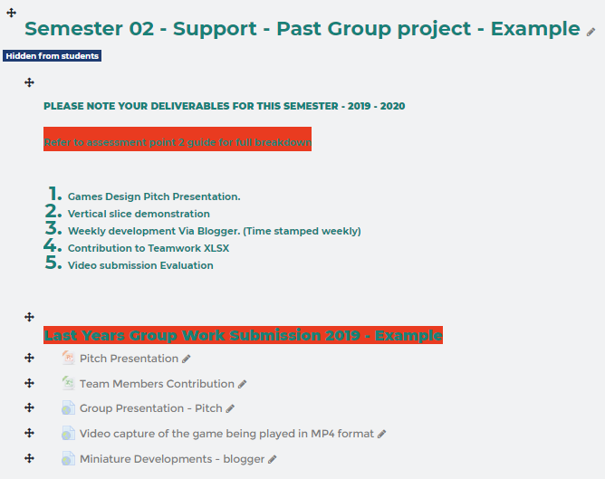
Break down on Deliverables
Games Design Pitch Presentation.
Vertical slice demonstration
Weekly development Via Blogger. (Time stamped weekly)
Contribution to Teamwork XLSX
Video submission Evaluation

Slide 13
2. Arrangements for submission is comprised of two parts
Individual assessment will be submitted online via Moodle for Part 04, Contribution to Teamwork XLSX.
All other deliverable's PART 01, 02, 03 & 05 will be made on a physical submission to the Park assessment room. One submission per group on a USB will be suffice. Each team must have a Cover sheet with names and student numbers on a polyfile. Contributors within each team and teams are responsible for the folder structure so it is in a intuitive structure so contents are easily identifiable.

Slide 14
How your work is marked individually
Please note each team members work is marked based on their contribution to the team project and everyone must make a technical contribution (IE, a project manager or administration role cannot be a substitute).
Please note teamwork is the collaborative effort of a team to achieve a common goal or to complete a task in the most effective and efficient way and communication is a key ingredient to this.

Slide 15
11. Special instructions
Special instructions
The games design pitch presentation must be in PowerPoint format and contain no more than 10-15 slides.
Screen capture of the game must be in MP4 format with voice over
Submit the practical elements on a USB stick to the Park Assignment Room ( Unity project files, playable web version, screen capture of game being played) with an Assignment Cover sheet for each group with names and student numbers in a polyfile. One submission per group is suffice and its is the teams responsibility to make sure the physical submission is delivered on time.
Submit the Contribution to Teamwork XLSX onto Moodle before the assignment deadline.

Slide 16
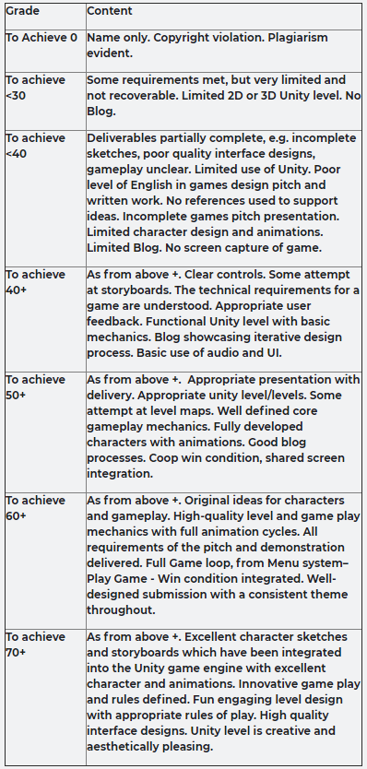
12 Assessment 1 criteria The grade table on the following page is a guide to the level of practical content required for the assignments. You need to achieve at least 40% to pass this assessment. Assesses learning outcomes (1) (2) (3) and (6)

Slide 17
Assignment 2
Please note:
All team members must make a technical contribution
Not sufficient to take on a purely administrative role
Note that it is expected that each team member contribute approx, 84 hours of independent study, in addition to the timetabled sessions, to the project.
Original Unity source files/media must be submitted
Intuitive team folder structure of each team members submitted work.
Contribution to Teamwork XLSX

Slide 18
Assignment 2
Please note:
Team presentations 05-May 2020
Include a short demo of the game
Every team member must contribute
Submit game/media/documentation to
Park Assignment Room on a USB 28th May 2018

Slide 19
Ground Rules for assignment 2
Team to run as a professional body
Respect each others ideas, skills & abilities
Decisions must be group based
Rather than arbitrary ones by an individual
Document the development process
Project plans, action plans, timesheets etc

Slide 20
Ground Rules for assignment 2
Tutors will act as the teams ‘upper’ management
In semester 2 meet advisor (Will or John) once a week
To discuss/demonstrate progress
Offer guidance
Facilitate conflict resolution

Slide 21
Ground Rules for assignment 2
Absences from any agreed meeting should be notified in advance by email (copy to tutors)
Failure to do this in the ‘real’ world would result in disciplinary procedures being instigated
In academic teams it will be deemed as unprofessional and negatively impact your grade

Slide 22
Teamwork
When people use their skills and knowledge together, the result is a stronger unit that can fulfill its mission
To build a prototype game
People working together can sustain the enthusiasm and lend support needed to complete the assignment
It is not possible to succeed in assignment 2 without people working together

Slide 23

Teamwork skills
Listen
Question
Persuade
Respect
Help
Share
Participate

Slide 24
Roles within teams? Ask……
Team Leader
Project Manager
Programmer
Character Designer
Environment designer
Object designer
Technical Author
Tester/QA
Level Designer
Audio Producer
Animator
Script/dialogue Writer
Concept Artist
Marketing
Finance
Interface designer

Slide 25
How will you work together?
Embrace the challenge.
Consider:
When will you work on the game?
Where will you work?
Together or as individuals?
Who is responsible for a given task?
Organised team
Each person should have a primary and a secondary function within the team
No one should have sole responsibility for a task
Or will you make it up as you go along?
Not recommended!

Slide 26
Organised teams
Make sure everyone has the same goals
How much effort?
Desired grade?
Competition?
Make sure everyone wants the same type and style of game
Genre (casual)
Game-play
Content
Appoint a project manager who will have overall responsibility for keeping track of activities

Slide 27
Team working for Games
Divide tasks equally
Individuals could have responsibility for key elements
Communication issues
Contingency arrangements required
Work as a team on all tasks
A different person takes the lead in each area
Shared responsibility/ownership
Requires close cooperation

Slide 28
Team working for Games
Real world games development requires skills across a range of disciplines
Small focused unit takes responsibility instead of an individual
For example, consider what skills are required to create the user interface?
Artist, Games Designer, Programmer & Tester
Issues:
Design by committee, i.e. compromise
Conflict occurs when team members cannot agree
Focus should be on decisions rather than considering new ideas
Such as in a brainstorming session

Slide 29
Your commitment?
3 hours per week
+7 hour lecture
16 weeks
144 hours per person
In a team of 4
= 720 hours of production time
Question:
Will your game look like it ‘cost’ 576 hours to produce?
If not, why not?
Staff |  | Hours worked
Tom |  | 144
Harry |  | 144
James |  | 144
Angela |  | 144
Sammy |  | 144
 | Total | 576

Slide 30
Where to start?
At the very beginning….
Decide look & feel of game
Task analysis & plan
Assign primary roles for team members
Agree ground rules
Set deadlines/agreed targets
Keep to them
Recognise that you will have other things to do over the next few weeks!

Slide 31


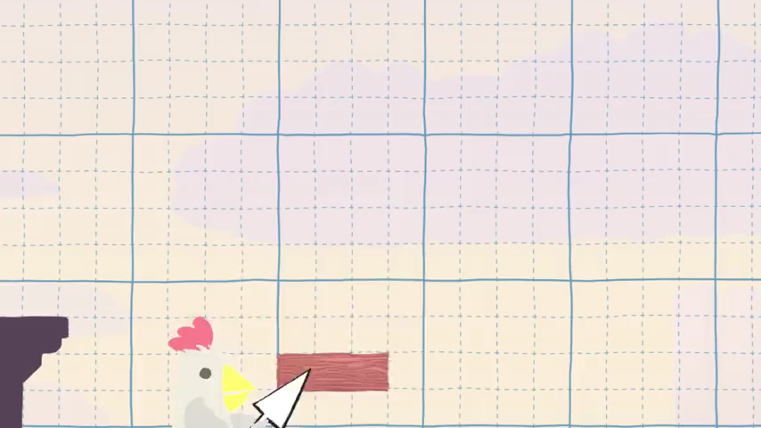
A casual 2D party game – Inspiration
With your brilliant robe and magic powers, it’s time to build some Tricky Towers! Stack your bricks in this land of fable, whose marvelous tower will be the most stable? Sold 177,329
Ultimate Chicken Horse is a party platformer game where you build the level as you play, placing traps and hazards to screw your friends over, but trying not to screw yourself. Sold 387,000
Enter the futuristic year of 1984, an age where ducks run wild in a frantic battle for glory. Sold 509,628

Slide 32

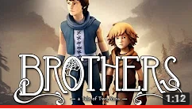
A casual 3D party game - inspiration

Slide 33
Games Design – Types
What is it about these games that make them so appealing and why are they so successful?
2D is more accessible to indies than 3D as its generally cheaper and technically simpler. Its also less resource intensive allowing it to work on lower end mobile hardware.
Lots of various pixel styles, more of this later.
Works well on less spec devices.
Mobile market is a huge sector.
Intuitive to play
Fast
Fun
Effective gameplay mechanic
Easy controls
Fun with friends
Learning curve small
Open to all audiences

Slide 34
Games Design - Why 2d?
More Engines are supporting 2D.
You can still earn a profit making 2D games. Many great mobile games succeed not because of the number of polygons and particle systems on-screen, but because they are fun to play.
2D is more accessible to indies than 3d as its generally cheaper and technically simpler.
Only 3-4 man teams are needed.
Its also less resource intensive allowing it to work on lower end mobile hardware.
Lots of various pixel styles, more of this later.
Mobile market is a huge sector, casual gamers.
2D games have established themselves as an independent art form.
Most game Jam products are 2d.

Slide 35


Games Design - Types
These games were made both in 24 hours by students here……
Brains Eden is the UK's largest student games festival, held annually at Anglia Ruskin University, Cambridge, UK and supported by some of the biggest games and technology companies in the world.
Here we had a games Jam held on the 7th-8th June, which we had some great results.

Slide 36

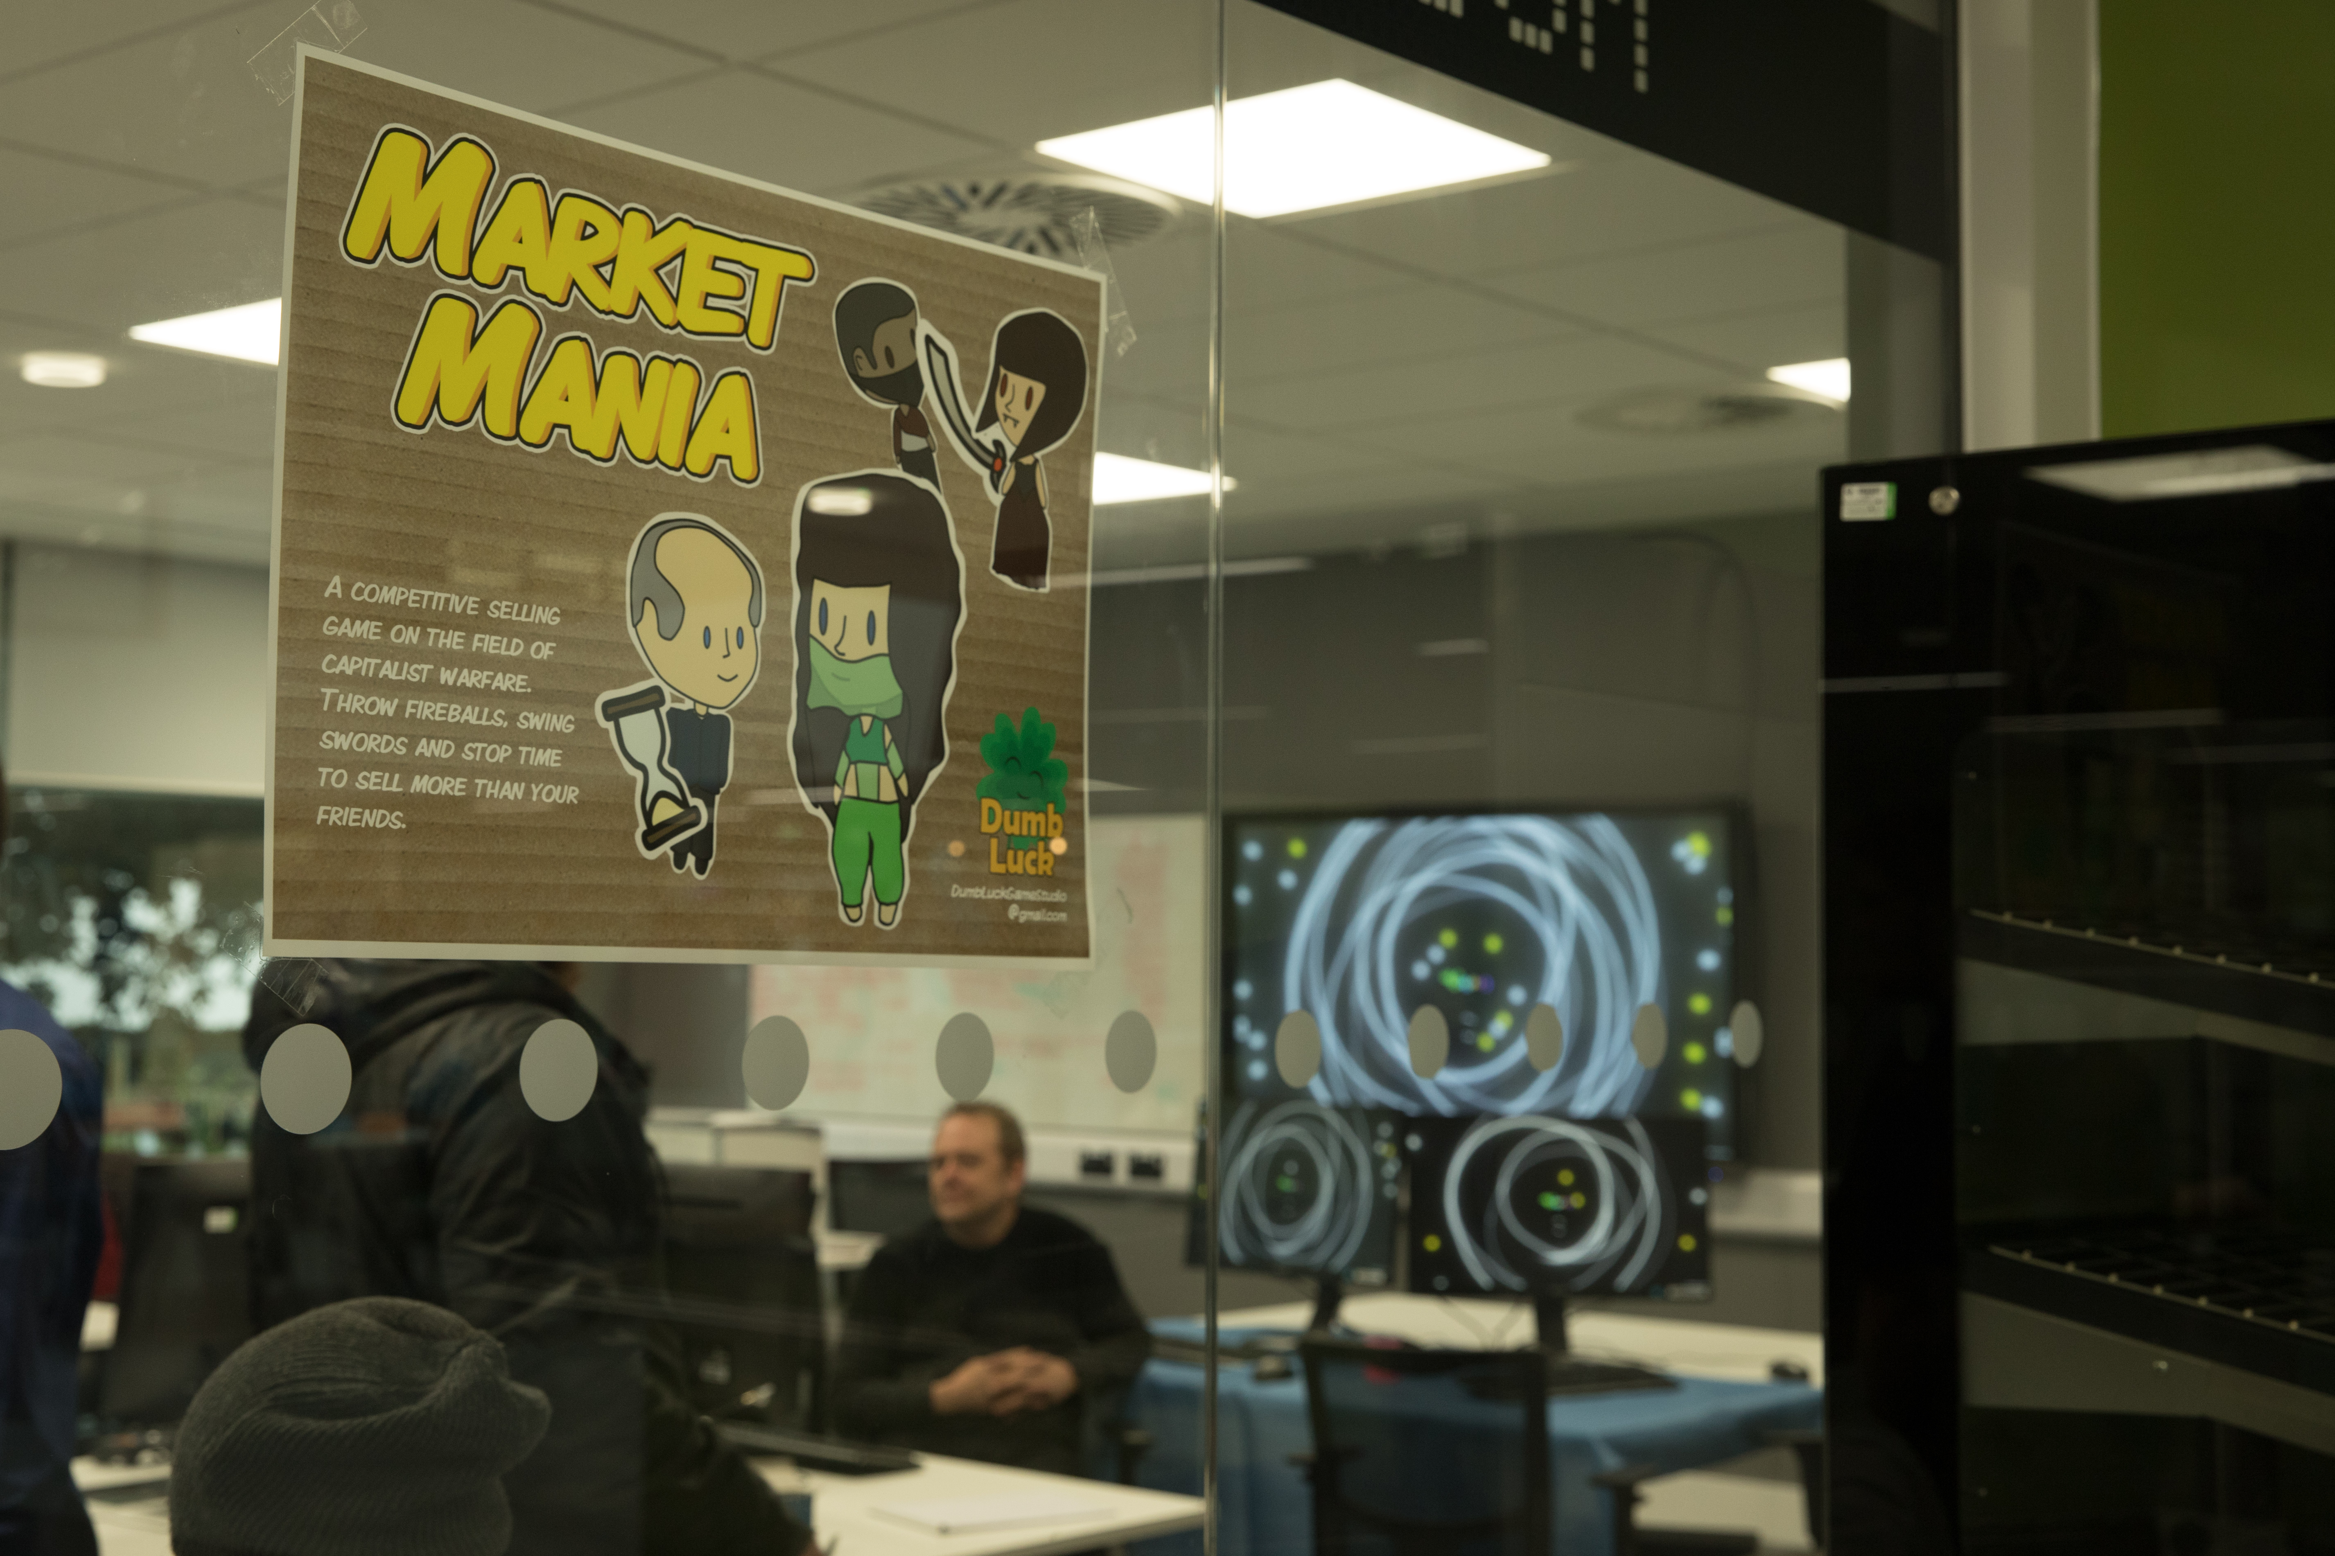
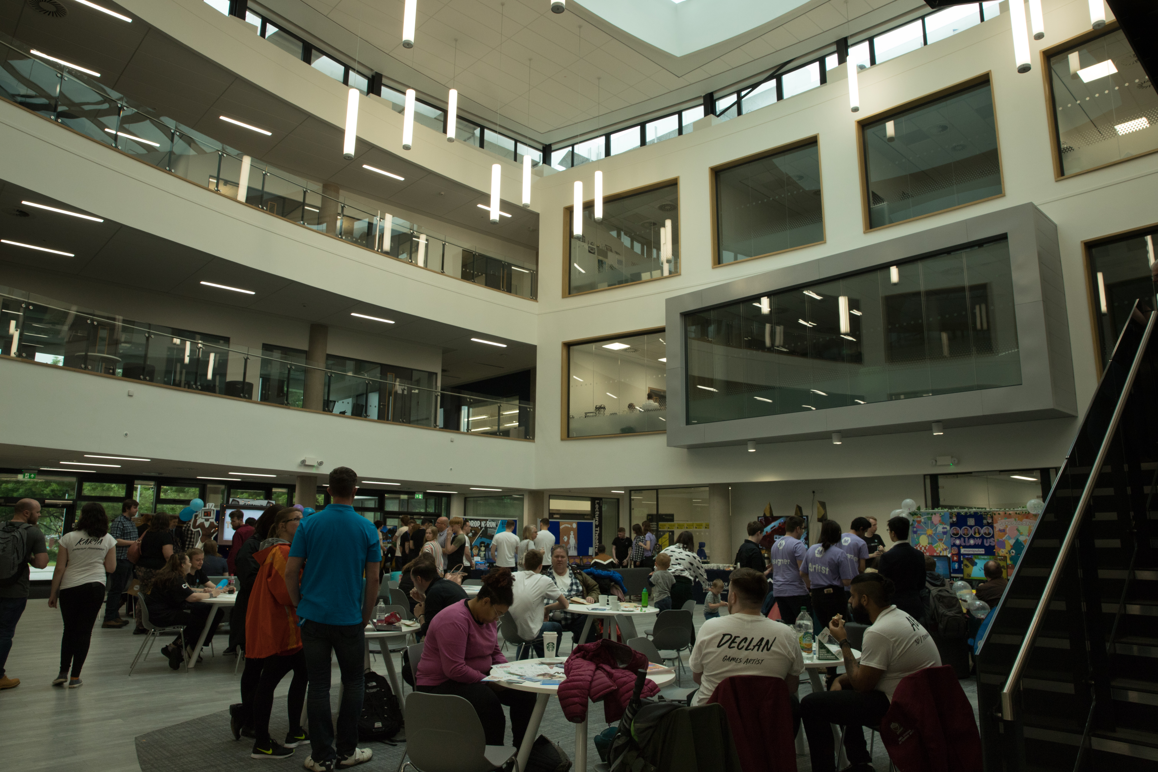
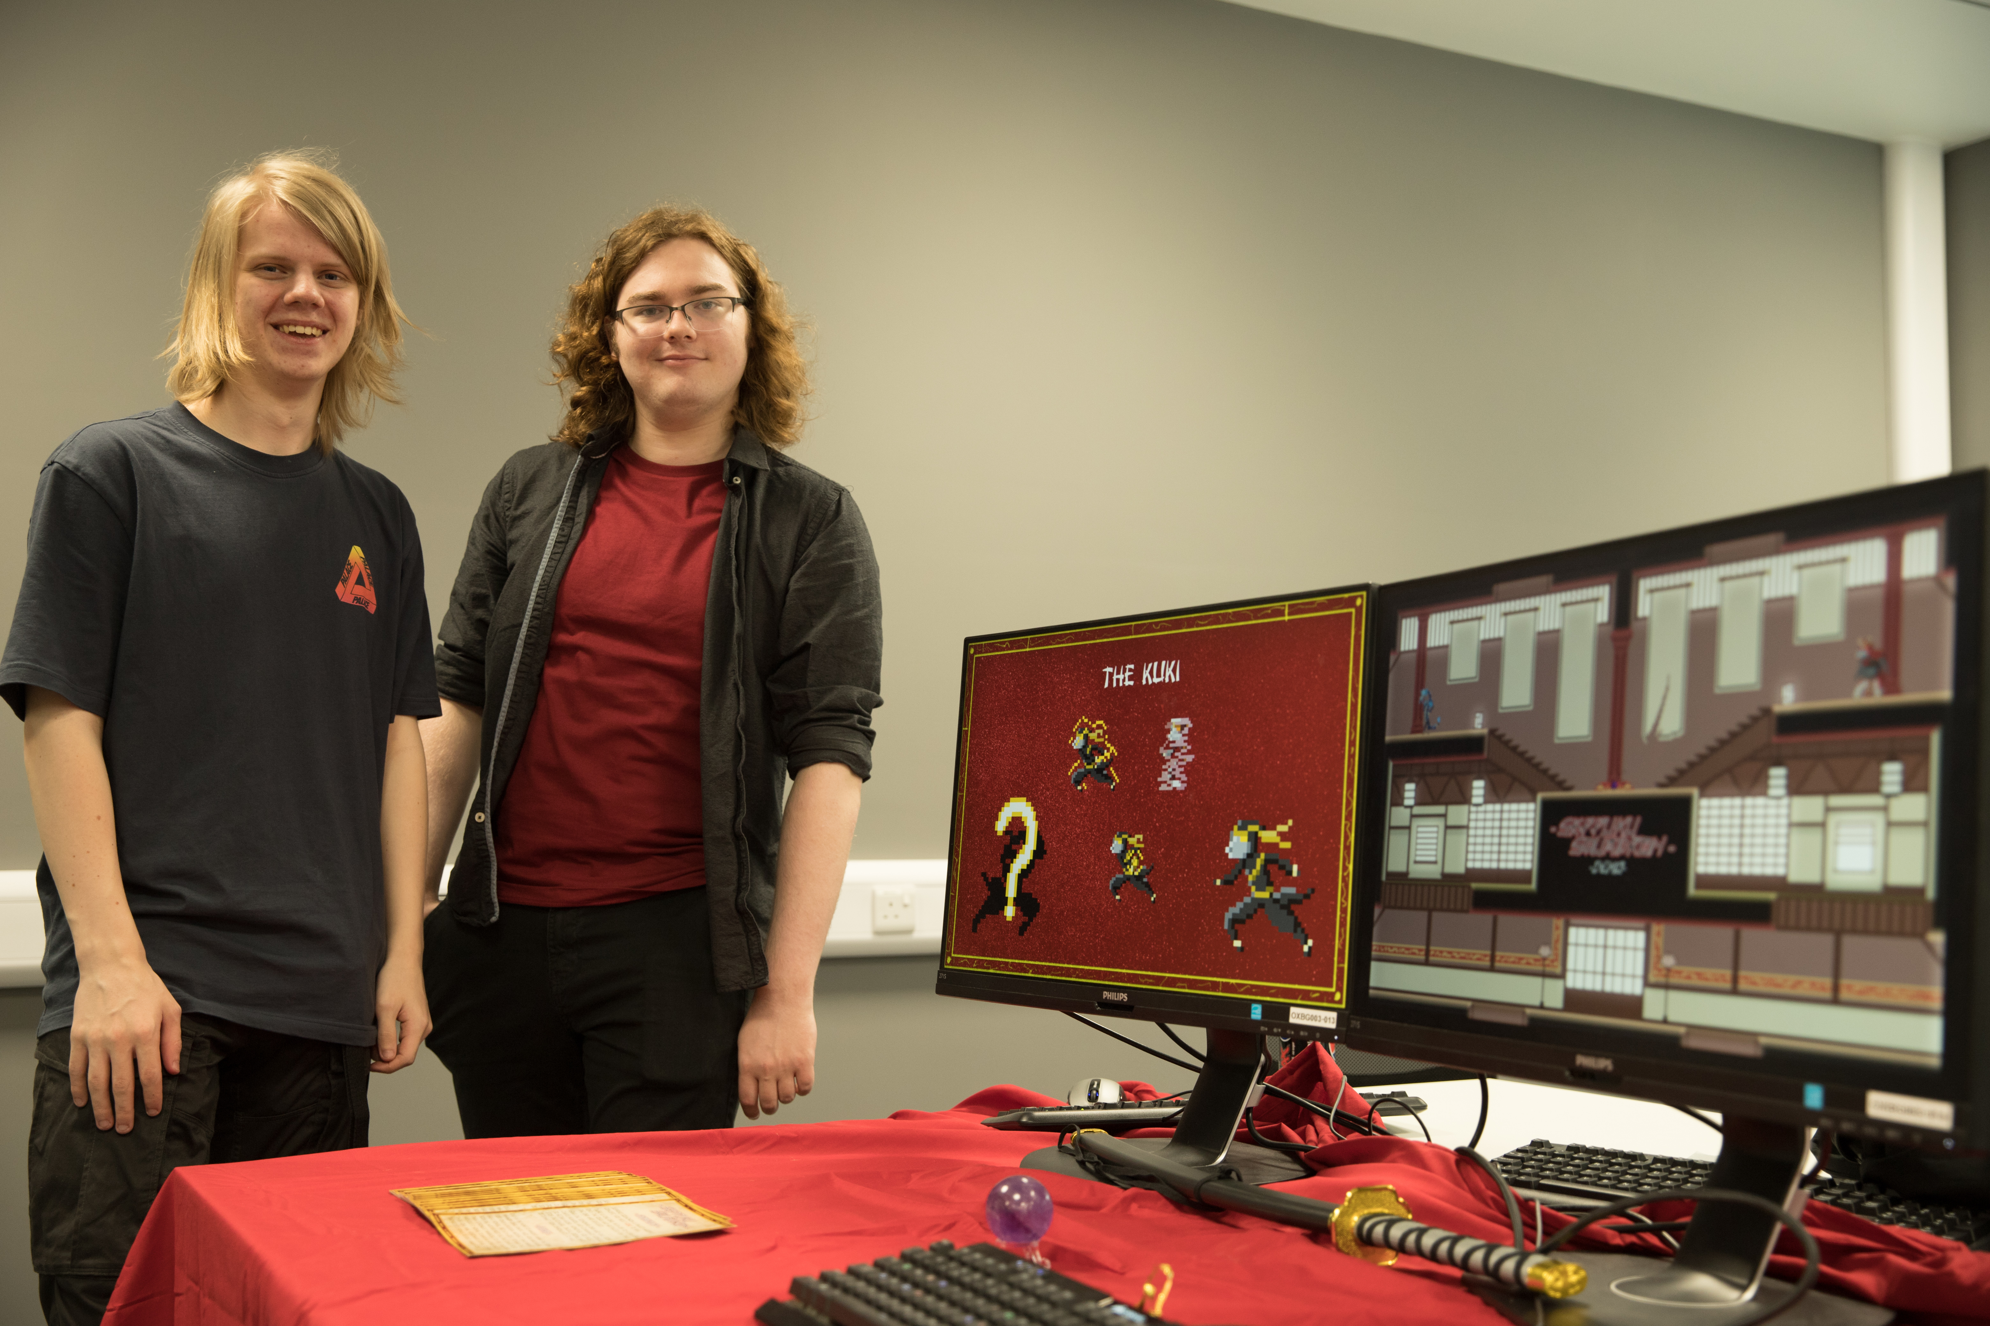
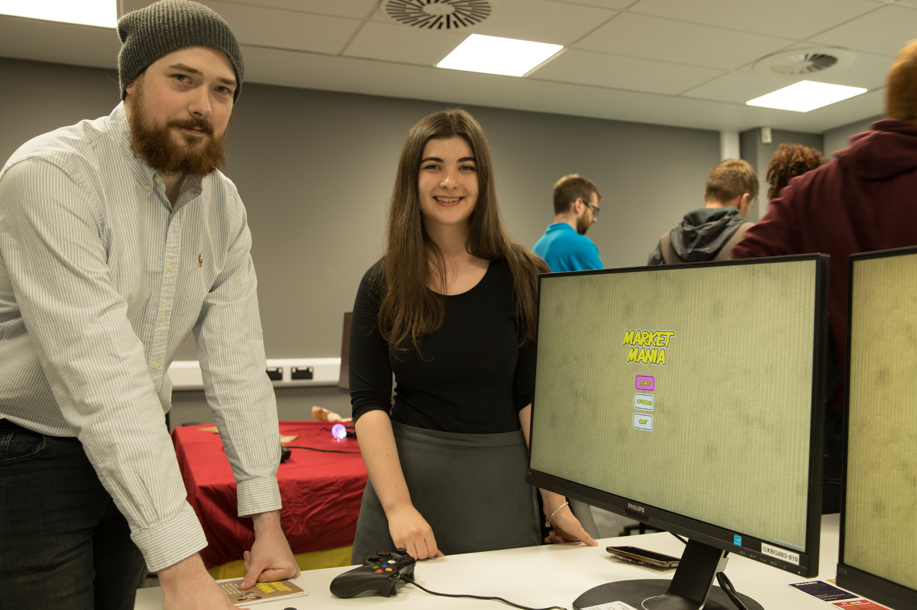
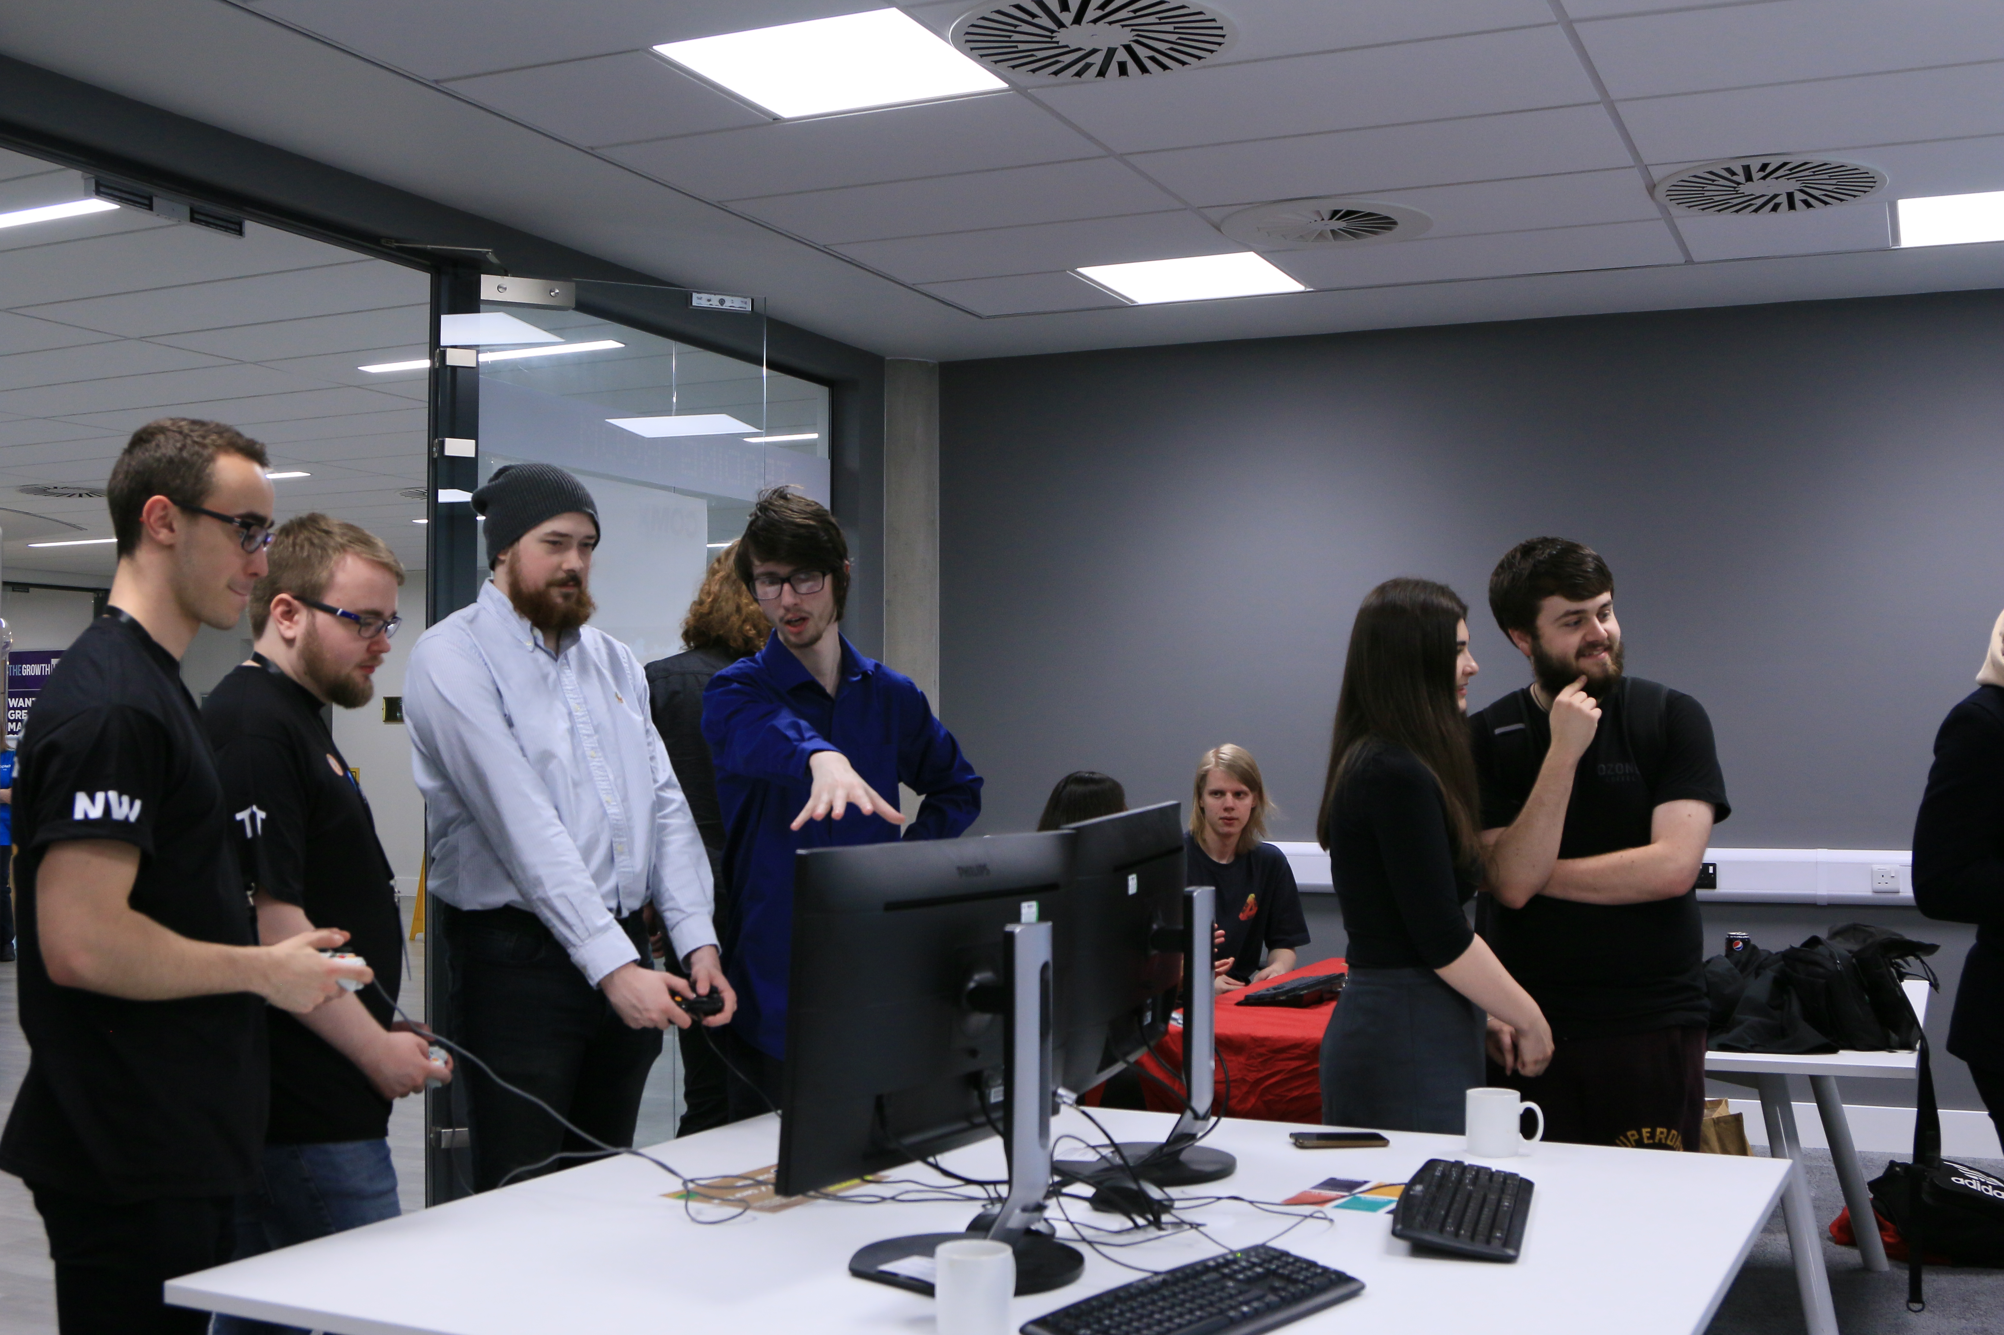
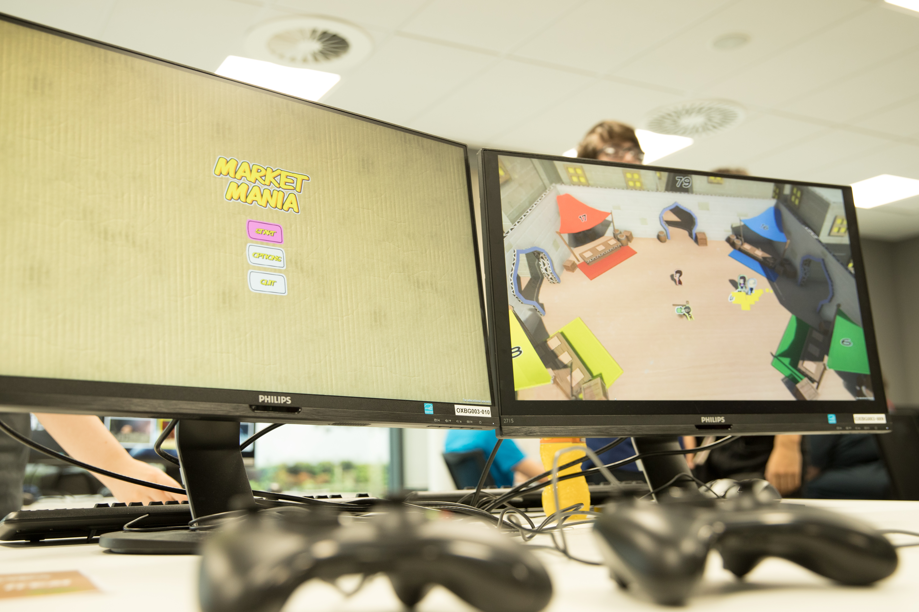
Level 4’s ☺

Slide 37
Release the Teams

Slide 38

Teams for the assessment 2
Teams have been totally randomised based on the theme of mixing designers (web) and Programmers
We have 16 Teams with 4 in each group with at least one programmer in each!!!!

Slide 39
Team 1 (John)
Webb, Harry - 1
Oldham, Harry - 2
Meghie, Kwuali - 1
Turner, Zack - 2
Team 2 (Will)
Ciesielska, Zuzanna - 1
Smith, Alex - 2
Minchin, Jodie - 1
Greenaway, Laura - 1
Team 3 (John)
De Brun, Killian - 1
Stanley, Jeffrey - 1
Bury, Miron - 2
Smith, Lucy - 1
Team 4 (Will)
Breathnach, Ruaridh - 2
Morris, Kieran - 1
Mathias, Abigail - 2
Northway, Henry - 1
Team 5 (John)
Vince, Chris - 1
Oldham, Daniel - 2
Reeve, Matthew - 1
Hobbs, Jordan - 1
Team 6 (Will)
Lawson, Jacob - 2
Ormerod, Jade - 1
Carmenita, Gabrielle - 1
Brown, Benjamin - 1
Team 7 (John)
Blackwell, Oli - 2
Kennedy, Andrew - 1
Smales, Blake - 1
Farlow, Iain - 2
Team 8 (Will)
Jackson, Kurt - 1
Davies, Ffion - 1
Brunning, Henry - 1
Kenny, Patrick - 2
Team 9 (John)
Coupland, Jaymz - 1
Sandys, Cameron - 1
Jenkins, Jordan - 1
Bansal, Liam - 2
Team 10 (Will)
Metcalf, Tim - 1
Clack, Daniel - 1
Butler, Tom - 2
Holland, Jamie - 2
Team 11 (John)
Stonechild, Robin - 1
Clarke, Chris - 1
Bunn, Lilliana - 2
Leong, Mark - 1
Team 12 (Will)
Gritton, Devon - 1
Hamer, Alex - 1
Land, Tom - 2
Simpson, Liam - 1
Team 13 (John)
Pudge, Phoebe - 2
Averiss, Gemma - 1
Netysy, Toby - 1
Reynolds, Will - 1
Team 14 (Will)
Hughes, Nigel - 1
Jackson, Joe - 2
Brown, Jake - 1
Lloyd, Ben - 1
Team 15 (John)
Linford, George - 2
Lewis, Conor - 2
Fisher, Millie - 1
Carlton Cunliffe 1
Team 16 (Will)
Rawlins, Josh - 1
Morgan, Anna - 2
Stevens, Jack - 1
Johnson, Chris - 1
Teams - Key - Designer =1 / Programmer =2

Slide 40
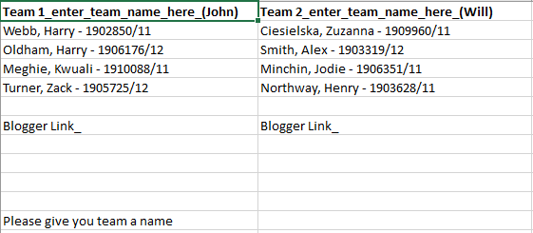

Todays Practical
Set up your eblogger and Team name please
Define a name for your team.
Then go you eblogger and then and make a blog based from your team name
teamname.blogspot.com
After this then can you please create a page and then publish.

Slide 41
Team Bonding - Truth and Lies
Time: 10 - 15 minutes Number of Participants: three or more people Tools Needed: None
Rules: Sit everyone in a circle facing each other. Have each person come up with three facts about themselves and one lie. The lie should be realistic instead of extravagant. Go around the circle and have each person state the three facts and a lie in a random order, without revealing which is the lie. After someone shares, the others must guess which is the lie.
Objective: This is a great ice breaker game, especially for new teams. Helps eliminate snap judgements of colleagues and gives introverts an equal chance to share some facts about themselves. Please respect each other!

Slide 42
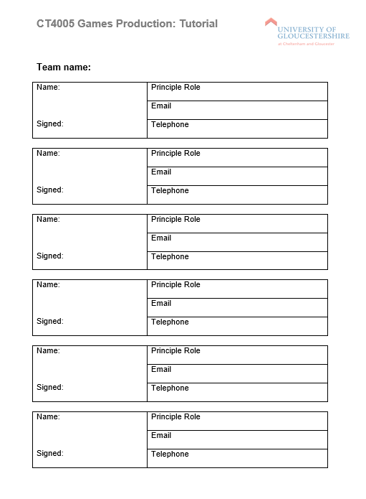
Team Bonding
Share your details with your new team members
You keep this.

Slide 43
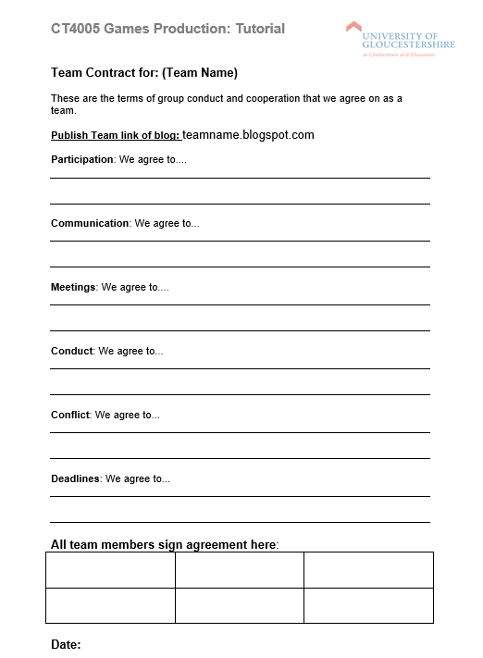
Team Bonding
Team contract
Sign in details
Link to your Blog
Send this page to your advisor please.

Slide 44
Self-study
Read through module guide carefully with reference to assignment 2
Start working on the assignment:
Brainstorm ideas for your game
i.e. consider title, 2D or 3D, genre, characters, rules etc
Read the content on Moodle
Competitive research / Play games
Create a spider diagram of your ideas

Slide 45
Summary
Ground rules for assignment 2
Effective Teamwork
Tutorial
Teams for Assignment 2
Get to know each other
Team bonding exercise

